Slide 1
6. Construct report using SQL*PLUS

Slide 2
Creating HTML Report
SQL*Plus is a command line interface to the Oracle database.
Oracle 8i and 9i allow the generation of reports directly from SQL*Plus.

Slide 3
Creating HTML Report
1. SET MARKUP HTML ON statement is used to produce HTML output.
2. SET ECHO command enables or disables displaying on the screen, characters (input) entered at the keyboard .
Syntax: SET ECHO OFF | ON
OFF Keeps commands from a script file not to be displayed on the screen while a script file is being executed.
ON Causes commands from a script file to be display on the screen as they are being executed.

Slide 4
Creating HTML Report
3. SPOOL command is used to write the output to a file.
If we want to print a report, the only way is to spool it to a file, then print that file.
SYNTAX: SPOOL file_name | OFF

Slide 5
Creating HTML Report
Run the following commands in SQL command line
SQL>SET ECHO OFF
SQL>SET FEEDBACK OFF
SQL>SET MARKUP HTML ON
SQL>SPOOL D:\emp1.html
SQL>SELECT * FROM emp;
SQL>SPOOL OFF
SQL>SET MARKUP HTML OFF
SQL>SET ECHO ON

Slide 6
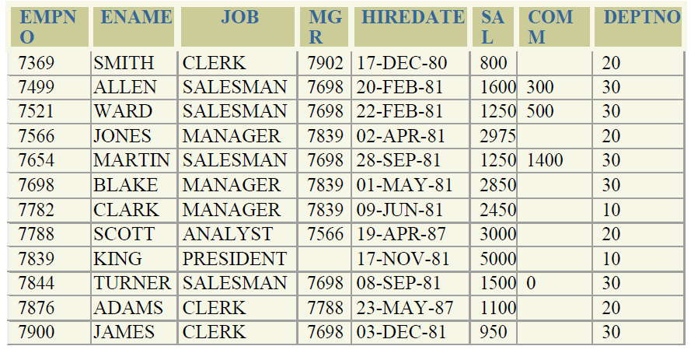

Slide 7
SQL>
create table emp1(empno number,ename varchar(20),job varchar(20),mgr number,hiredate date,sal number,comm number,deptno number);
insert all
into emp1 values(7369,'SMITH','CLERK',7902,'17-DEC-80',800,NULL,20)
into emp1 values(7499,'ALLEN','SALESMAN',7698,'20-FEB-81',1600,300,30)
into emp1 values(7521,'WARD','SALESMAN',7698,'22-FEB-81',1250,500,30)
into emp1 values(7566,'JONES','MANAGER',7839,'02-APR-81',2975,NULL,20)
into emp1 values(7654,'MARTIN','MANAGER',7839,'28-SEP-81',1250,1400,30)
into emp1 values(7369,'BLAKE','CLERK',7902,'01-MAY-81',2850,NULL,30)
into emp1 values(7782,'CLERK','MANAGER',7839,'09-JUN-81',2450,NULL,10)
into emp1 values(7788,'SCOTT','ANALYST',7566,'19-APR-87',300,NULL,20)
into emp1 values(7839,'KING','PRESIDENT',NULL,'17-NOV-81',5000,NULL,10)
into emp1 values(7844,'TRUNER','SALESMAN',7698,'08-SEP-81',1500,0,30)
into emp1 values(7876,'ADAMS','CLERK',7788,'23-MAY-87',1100,NULL,20)
into emp1 values(7900,'JAMES','CLERK',7698,'03-DEC-81',950,NULL,30)
SELECT * FROM DUAL;
SELECT * FROM EMP1;

